Slide 1
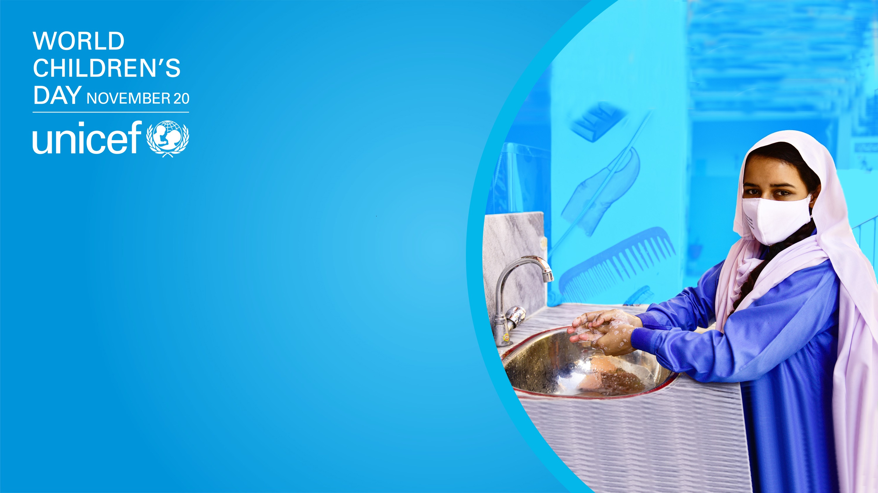
Covid-19 Response Review
UNICEF Pakistan
November 2020

Slide 2
Purpose and Objectives
Purpose: To outline the revised approach to RCCE in the context of COVID Wave 2 in Pakistan
Key objectives
To share key epidemiology and social / behavioral information and insight on the pandemic
Highlight strategic change in approach to RCCE
Advocate for coordinated approach in high burden districts.

Slide 3
COVID-19 Status in Pakistan: 25-Feb to 19-Nov 2020
Tests: 36,899
Cases: 2,547 (6.90%)
Source: Adapted from NCOC Pakistan. 16 Nov, 2020

Slide 4
COVID Mortality Trends in Pakistan (n=7,248)
Source: Adapted from NCOC Pakistan. 19 Nov, 2020

Slide 5
COVID Situation in Major Cities
Province | District | Covid-19 Lab Tests in Last 24 hours | COVID-19 Lab. Confirmed Cases in Last 24 hours | Positivity %
PUNJAB | LAHORE | 5,720 | 304 | 5.31%
 | RAWALPINDI | 1,203 | 61 | 5.07%
 | FAISALABAD | 506 | 15 | 2.96%
 | MULTAN | 592 | 68 | 11.49%
 | GUJRANWALA | 212 | 7 | 3.30%
SINDH | KARACHI | 6,644 | 841 | 12.66%
 | HYDERABAD | 645 | 97 | 15.04%
KP | PESHAWAR | 1,201 | 103 | 8.58%
 | SWAT | 269 | 6 | 2.23%
 | ABBOTABAD | 292 | 18 | 6.16%
BALOCHISTAN | QUETTA | 640 | 39 | 6.09%
ISLAMABAD | ISLAMABAD | 6,132 | 407 | 6.64%
AJK | MIRPUR | 203 | 18 | 8.87%
 | MUZAFFARABAD | 87 | 1 | 1.15%
GB | GILGIT | 70 | 5 | 7.14%
21 high burden districts (14 districts + 7 in Karachi)
Consistent high case load since October 2020
High test positivity rate

Slide 6
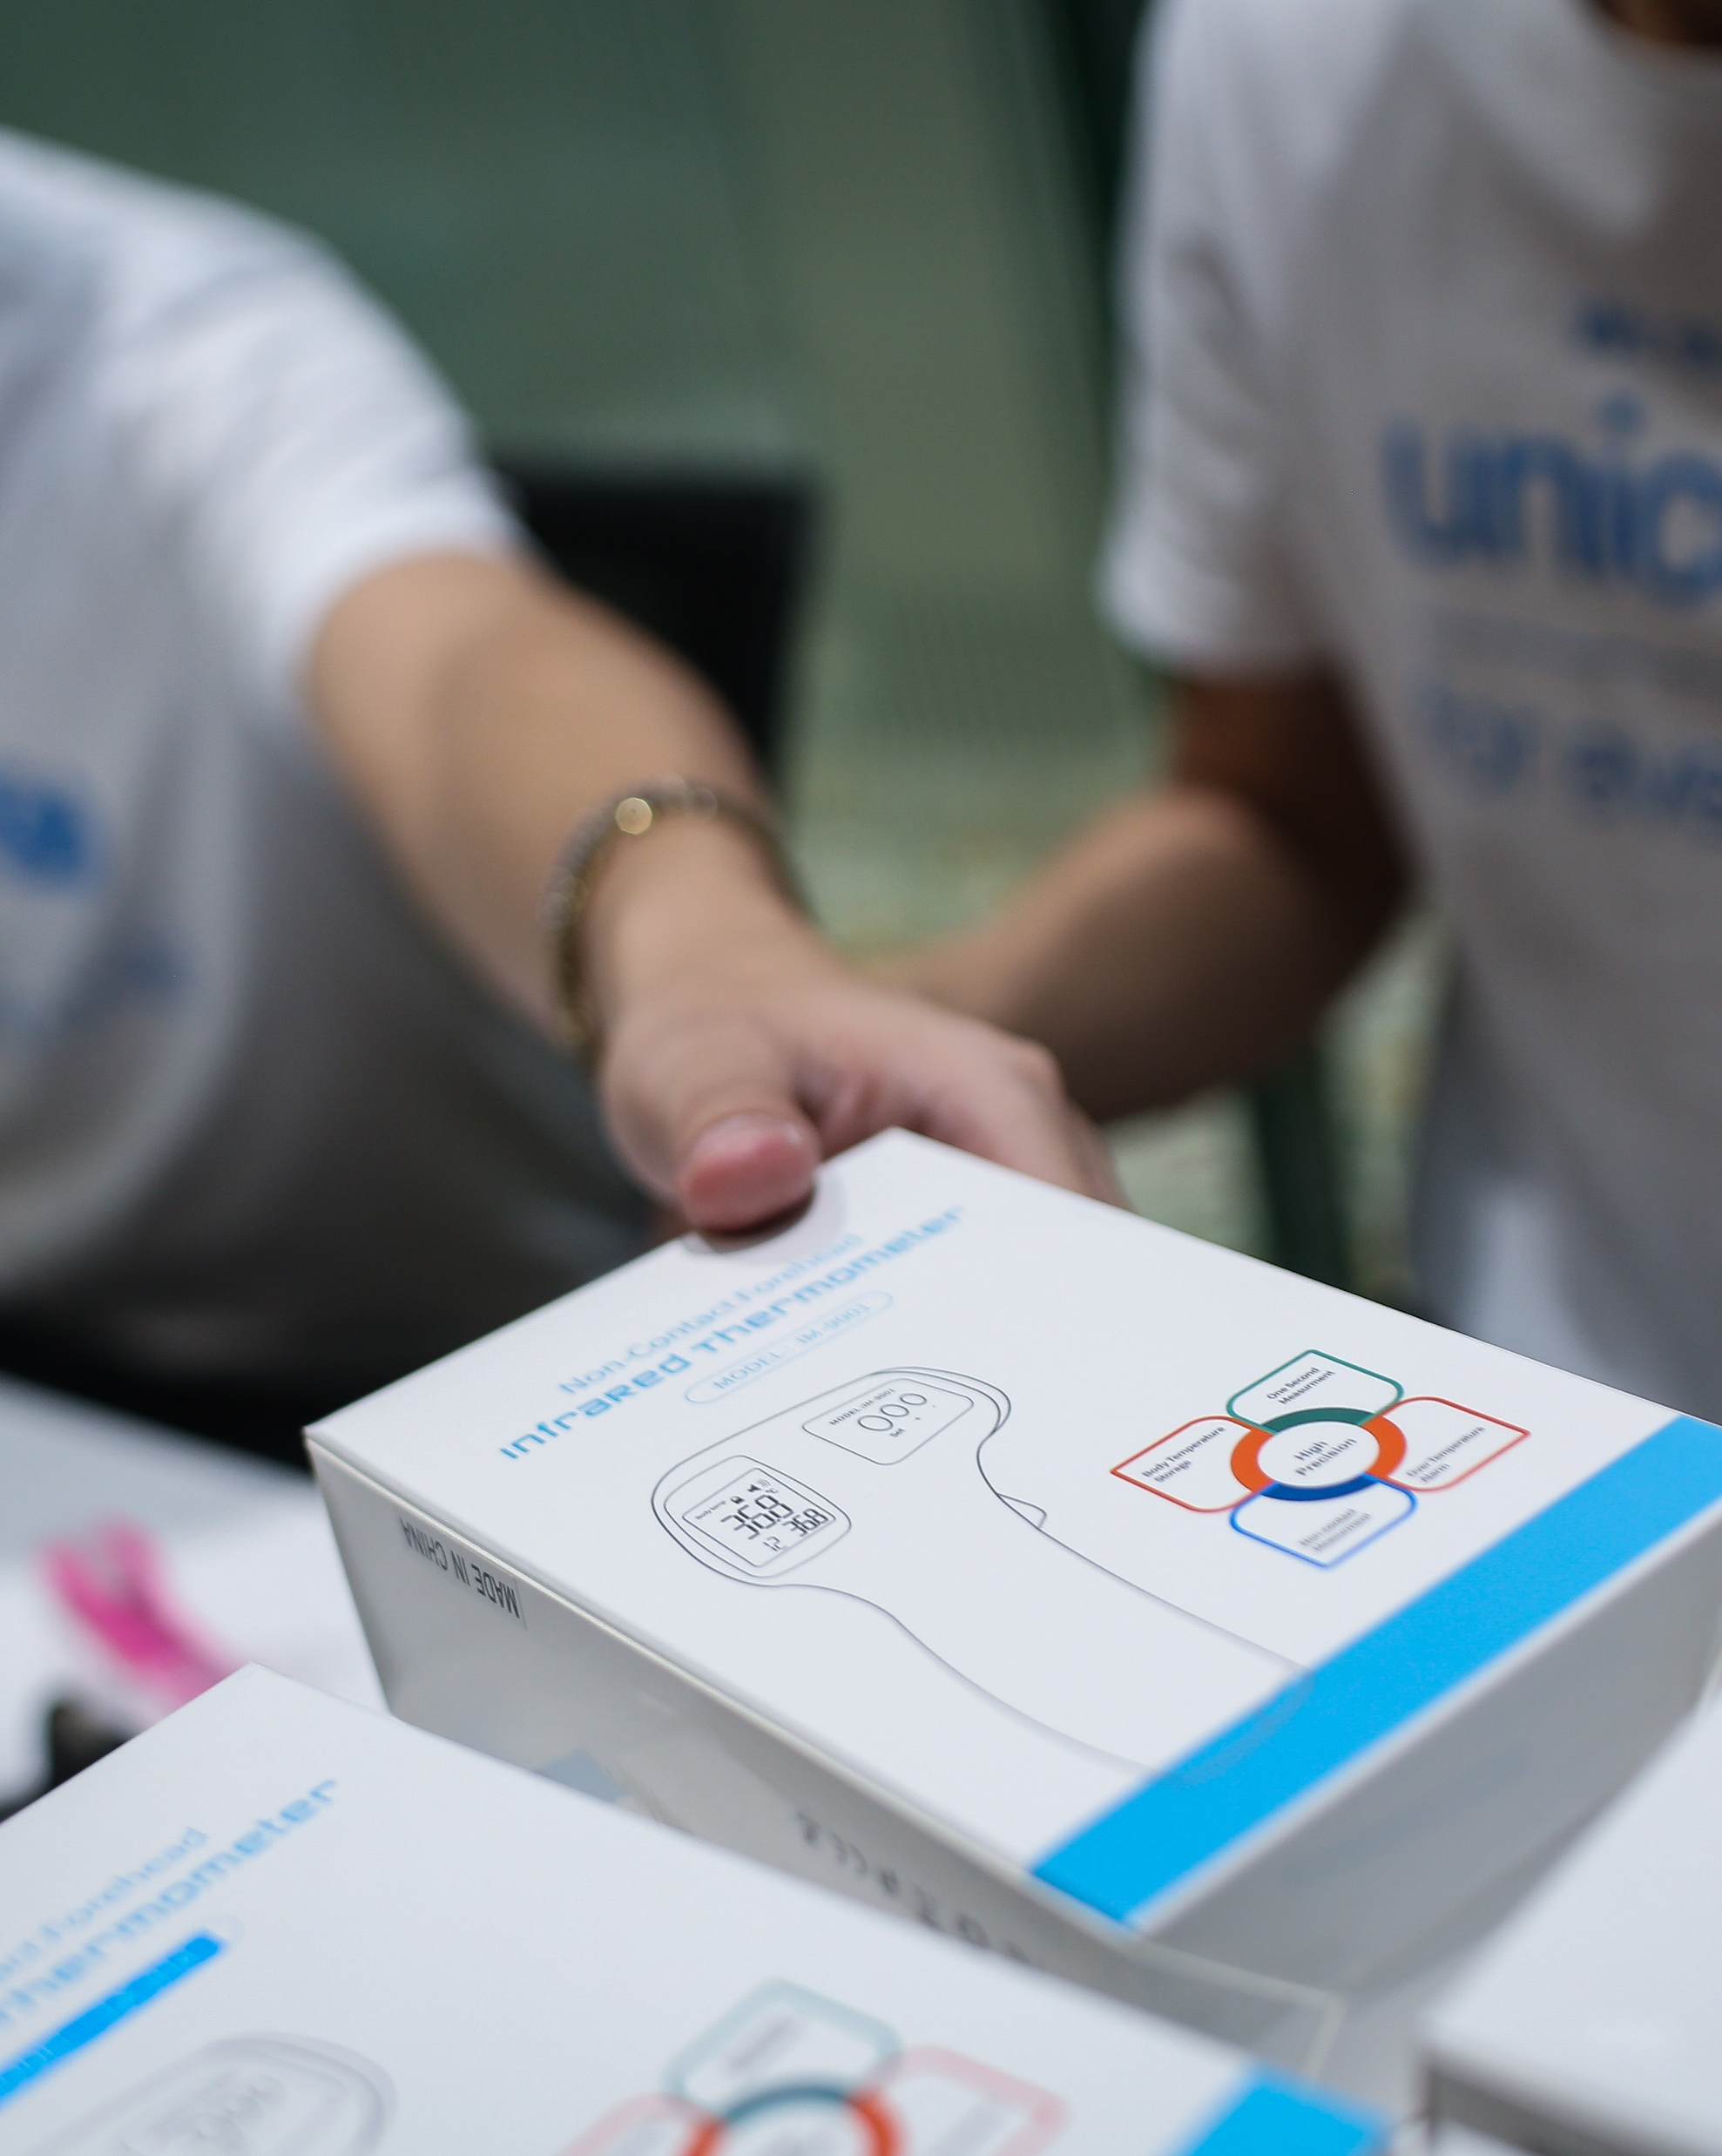
Longitudinal Community Rapid Assessment (CRA): Background
A Rapid mobile-based population short survey on behavior, coping strategies and communication channels during COVID-19.
To examine behaviors and drivers using mobile phone-based population surveys in a time series in order to assess relevance and to better prepare UNICEF to address future pandemics.
To demonstrate a lightweight methodological approach that can be used in other sectors with a relatively small budget envelope.
To routinely use social and behavioral population surveys as part of a data source in understanding the organizations effectiveness, relevance, etc., in evaluation designs.
© UNICEF/PHOTO CREDIT
Find Concept Note here
3 | Community Rapid Assessment on COVID: Pakistan

Slide 7
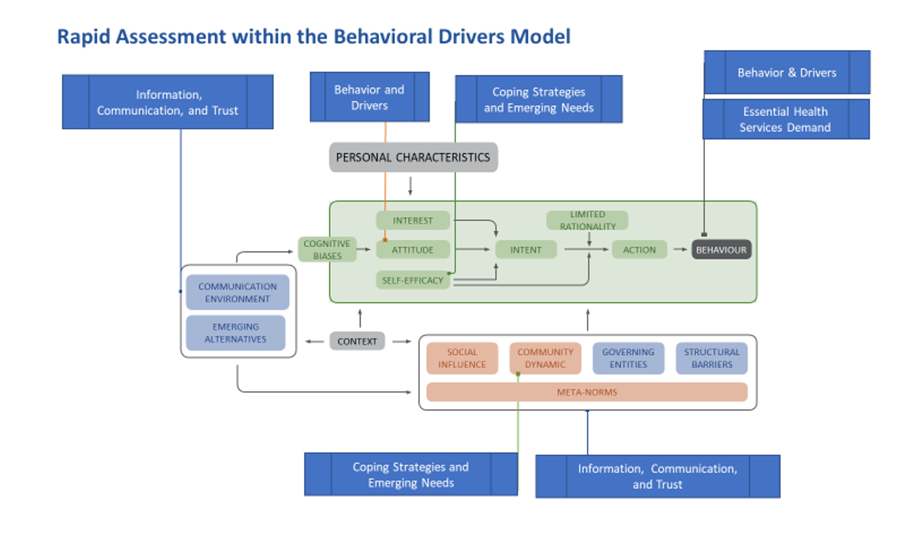
Longitudinal Community Rapid Assessment (CRA): Study Framework
To use population mobile-phone based surveying methods to examine behavioral changes, coping strategies, and evolving needs during the COVID-19 pandemic to inform programming and public policy efforts.
7 | CRA PakistanO: Early Findings
4 | Community Rapid Assessment on COVID: Pakistan
Notes:
On the CRA approach, you can add that it has been flexible in Pakistan with trying to accommodate countries specific questions in questionnaire and also it integrated with existing KAp sudies in Madagascar and South Sudan

Slide 8
Longitudinal Community Rapid Assessment (CRA): Survey Design
Methodology
Data Type: Quantitative, repeated cross-sectional time series.
Periodicity: Multiple rounds
Geographic Coverage: National and sub-national
Sampling & Sample Size: Probabilistic; ~N=1,000
Instrument: Short quantitative survey with standardized questions with room for country adaptation (Max 24 questions)
Demographic variables:
a) Sex,
b) Age,
c) Education, and
d) Urban/Rural Setting
Data Collection Modalities
Random Digital Dialing using Interactive Voice Recording Survey
Internet based survey for those with digital access and literate
Quality Control
Pre-survey testing
Methodological review of instruments
Ex-Post facto sample weighting**
Survey questions
Module 1: Behaviour and practices
Module 2: Coping strategies and emerging need
Module 3: Information and communication sources and trus

Slide 9
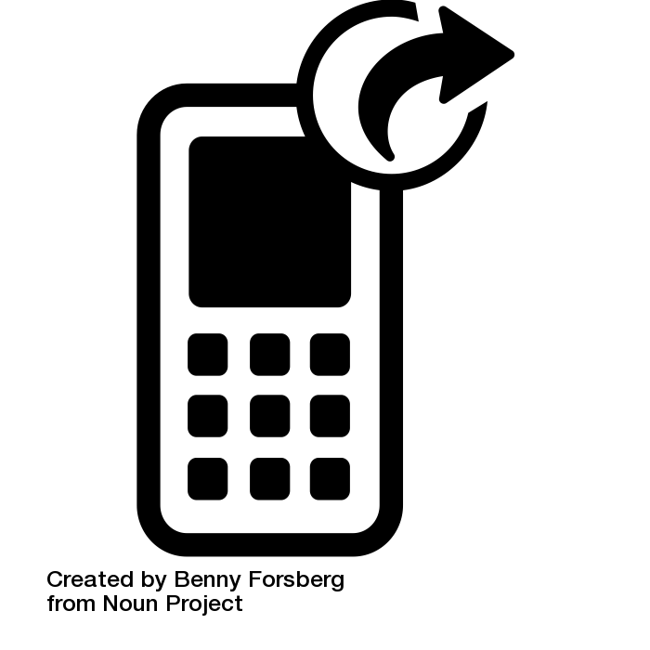
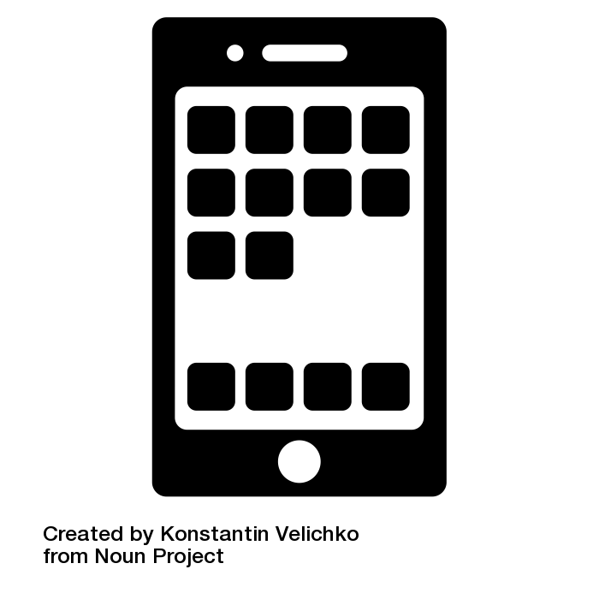

Longitudinal Community Rapid Assessment (CRA): Data collection process
A sample decision matrix to determine the best channel (robocalls, SMS, internet) for outreach and data collection in a diverse digital environment
Mobile technologies used for RCCE Survey
IVR/Robocall surveys for 2-way communication with difficult to reach population in rural or hard to reach locations
Internet for advanced engagement with fully literate target groups (access to smartphones, can afford mobile data)
Data points considered while designing campaign included: location, gender, ARPU, type of device ownership, network behavior and content preferences
 | Round 1 (August 2020) | Round 2 (Sept 2020) | Round 3 (Oct 2020)
IVR/Robocall survey | 3,152 | 2,689 | 2,383
Internet survey | 986 | 888 | 1,105
Total | 4,137 | 3,577 | 3,488
Source: UNICEF / Viamo Longitudinal CRA, October 2020

Slide 10
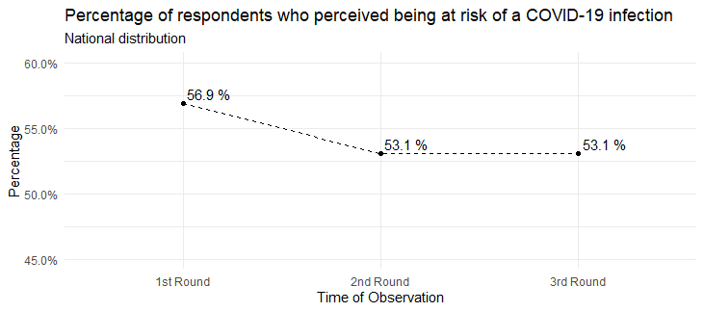
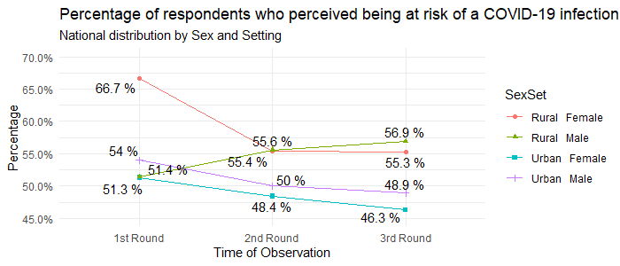
Covid-19 Risk Perception
Source: UNICEF / Viamo Longitudinal CRA, October 2020

Slide 11
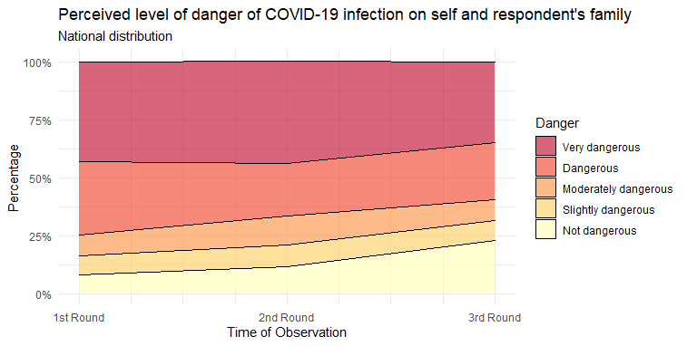
Covid-19 Risk Perception
Source: UNICEF / Viamo Longitudinal CRA, October 2020

Slide 12
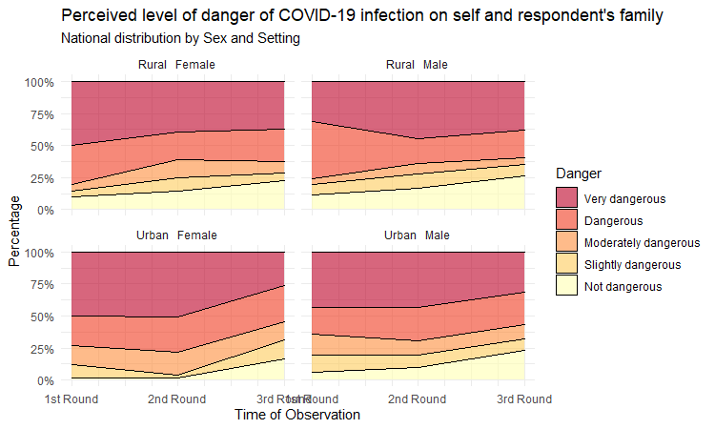
Covid-19 Risk Perception
Source: UNICEF / Viamo Longitudinal CRA, October 2020

Slide 13
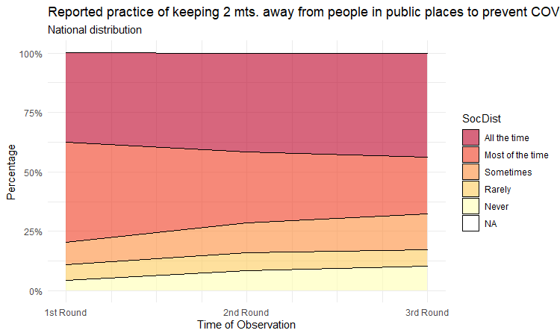
Covid-19 Practice of Prevention Behaviours – Social Distance
Source: UNICEF / Viamo Longitudinal CRA, October 2020

Slide 14
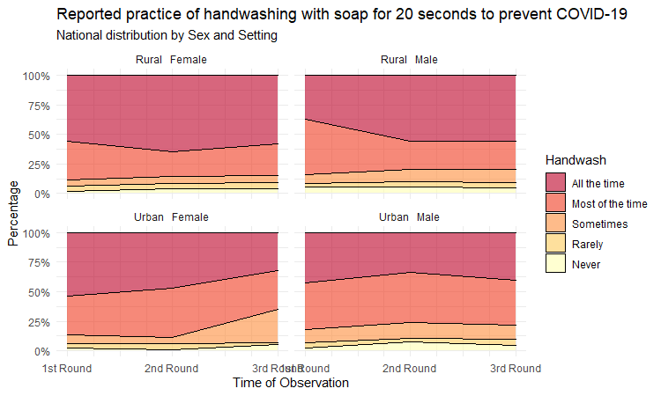
Covid-19 Practice of Prevention Behaviours - Handwashing
Source: UNICEF / Viamo Longitudinal CRA, October 2020

Slide 15
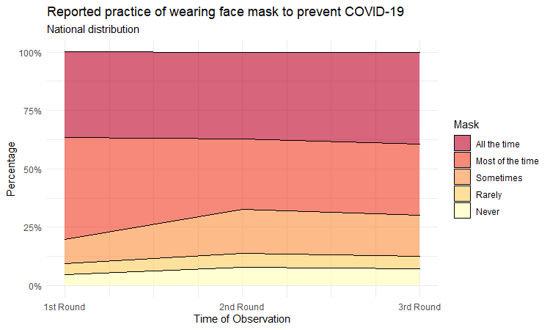
Covid-19 Practice of Prevention Behaviours – Mask Use
Source: UNICEF / Viamo Longitudinal CRA, October 2020

Slide 16
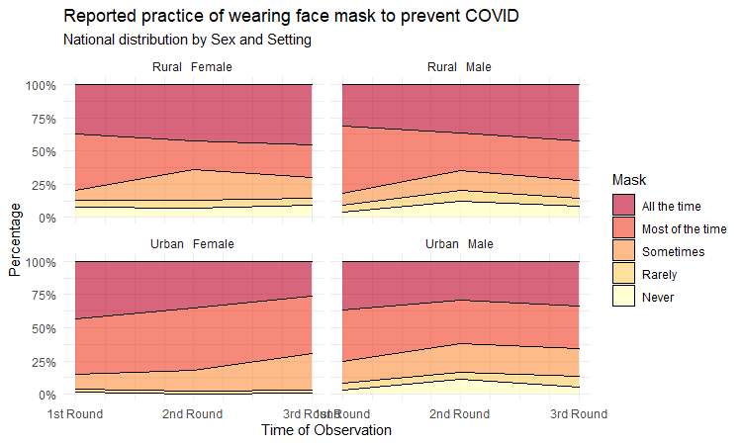
Covid-19 Practice of Prevention Behaviours – Mask Use
Source: UNICEF / Viamo Longitudinal CRA, October 2020

Slide 17
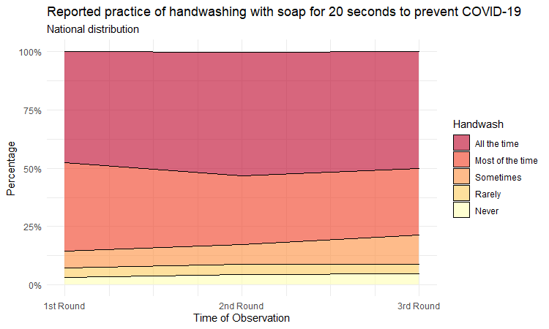
Covid-19 Practice of Prevention Behaviours - Handwashing
Source: UNICEF / Viamo Longitudinal CRA, October 2020

Slide 18
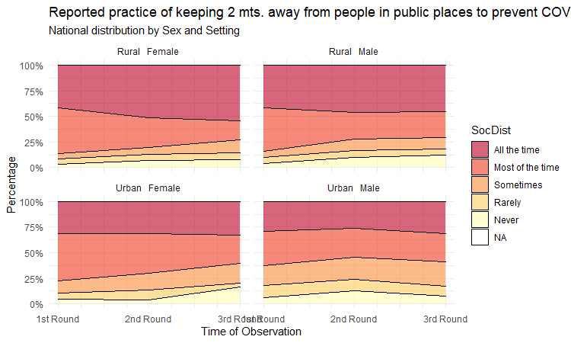
Covid-19 Practice of Prevention Behaviours – Social Distance
Source: UNICEF / Viamo Longitudinal CRA, October 2020

Slide 19
Covid-19 Health seeking Behaviour Practices
Source: UNICEF / Viamo Longitudinal CRA, October 2020

Slide 20
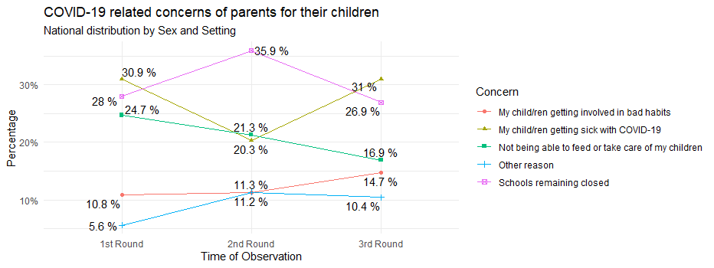
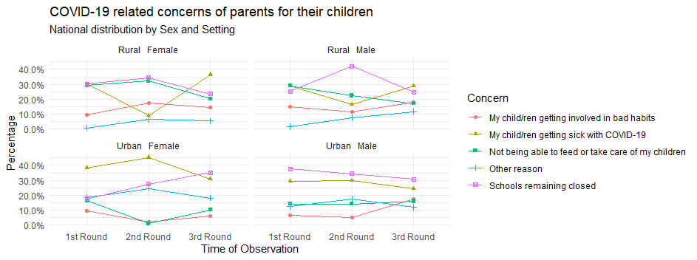
Covid-19 Related Concerns of Parents for their children

Slide 21
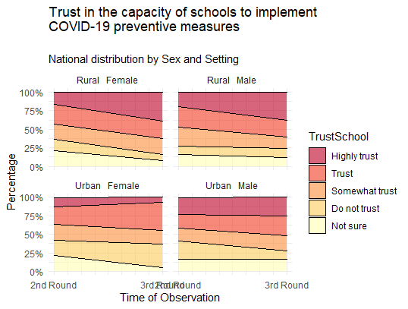
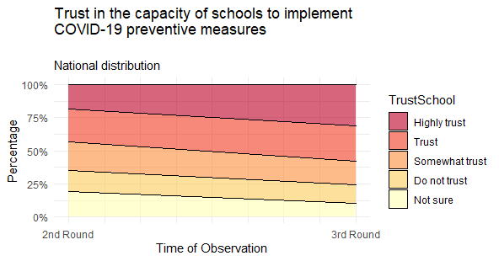
Covid-19 Related Concerns of Parents for their children
Source: UNICEF / Viamo Longitudinal CRA, October 2020

Slide 22
Covid-19 Related Stigma
Source: UNICEF / Viamo Longitudinal CRA, October 2020

Slide 23
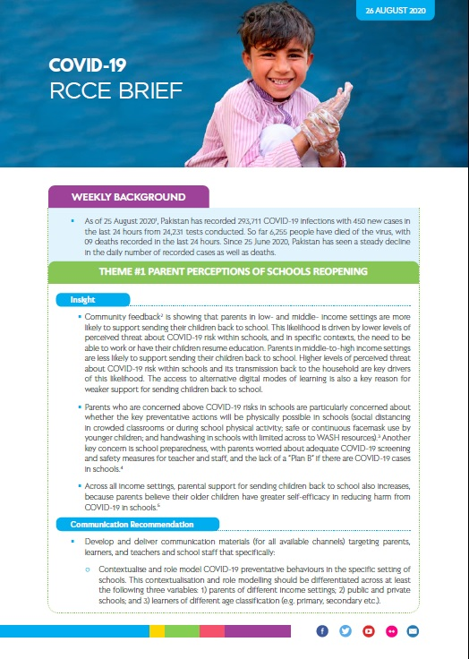
Behavioural insight: RCCE Briefs
Too many mixed messages. News media continue to confirm that Pakistan has overcome Covid-19. This worsen by the perception that the Country has achieved population immunity based on a partial study report of September 2020 – reinforcing the low risk perception.
Non structured, non-targeted public information (on news and social media) which is promoting message disregard, poor recall and poor message outreach
The strongest influence on behaviour is not coming from the media and scientific descriptions, but instead from peers around them.
Enforcement of SOP is important, however studies show that there will be strong resistance. The lack of is impacting the behaviors related to wearing masks in public and respect of SOPs in public places is to enforce them
Messaging on correct use of Mask and modelling of Mask Use by Government officials and influencers required to drive practice
Dedicated Urban strategies There is a need for dedicated and differentiated strategies and approaches for urban slums, and addressing youth (20-40)
Source: RCCE Brief # 28, November 2020

Slide 24
Strategic Approach for RCCE in Wave 2
Differentiated approach – concerted RCCE efforts on the high burden districts while maintain mass media communication nationwide
District level coordination – established in the high burden areas together with WHO and partners in support of the District Health Office and the Deputy Commissioners
Message rebranding – with focus on risk perception and promotion of appropriate ways to practice the prevention behaviors including incentives for compliance
Communication channels –
Community engagement through 4 platforms (CSO, Religious leaders, polio communication platforms and youth networks) in the high burden areas
Mass media through electronic and social media, nation-wide plus billboards, call lines and targeted social media messaging in high burden locations
One time high level social-media event to re-ignite focus on Wave 2 of Covid in Pakistan
Social analytics through on going community feedback mechanisms (call lines and social media platform) and CRA

Slide 25
Monitoring indicators
Outcome Indicators (CRA)
At least 80% of respondents are aware that the use of face masks, social/physical distancing and hand washing can reduce risk of Covid-19 infection (prevention knowledge)
100% of respondents perceive themselves at risk of Covid-19 (Risk perception)
Output Indicators (Programme Monitoring)
# of people reached through community engagement and media
# of religious leaders who continuously promote key SOPs
# of people reached through Social media
Operational indicators for high burden district level coordination (coordination report)
Number of high burden district with functional RCCE coordination team
Number of CSOs engaged on RCCE activities in each high-risk district
Number of religious leaders / influencers identified and engaged in each district
Number of youth/youth groups engaged in RCCE activities in each district.
Number of women leaders engaged in RCCE activities in each districts

Slide 26
Ask to the UN-CMT
Commitment to the high burden district
Facilitation of the establishment of a robust coordination team in the high burden district beyond RCCE to include surveillance and IPC at a minimum
Support and participation in the one-time social media event – it may be Nation a/ Provincial
Modelling of the behaviors
Resource mobilization for RCCE
Source: RCCE Brief # 28, November 2020

Slide 27

Thank you
For more information, please contact:
UNICEF Pakistan Country Office
Street No. 5, Diplomatic Enclave
Sector G-5, Islamabad Pakistan.
Ms. Aida Girma, UNICEF Representative agirma@unicef.org
Dr. Tajudeen Oyewale, UNICEF Deputy Representative toyewale@unicef.org
Mr. Jonathan David Shadid, UNICEF Chief of Communication for Development, jdshadid@unicef.org
Ms. Zohra Nisar Hunzai, UNICEF Communication for Development Specialist, znhunzai@unicef.org

